Slide 1
Tree

Slide 2
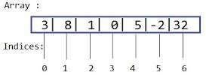
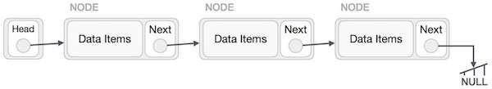
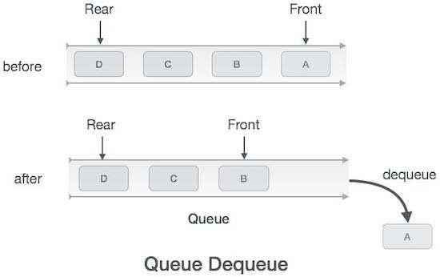

So far we discussed Linear data structures like
stack

Slide 3
Introduction to trees
So far we have discussed mainly linear data structures – arrays, lists, stacks and queues.
Now we will discuss a non-linear data structure called tree.
Trees are mainly used to represent data containing a hierarchical relationship between elements, for example, records, family trees and table of contents.
Consider a parent-child relationship

Slide 4
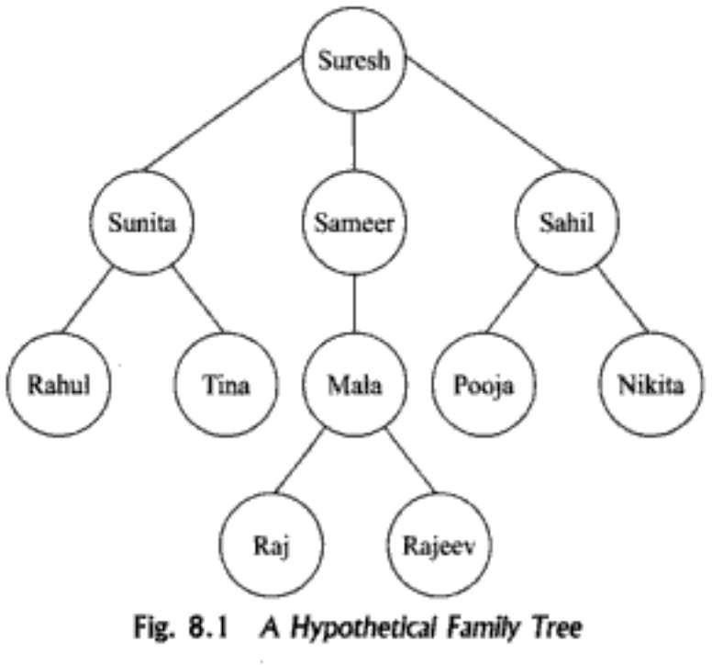

Slide 5
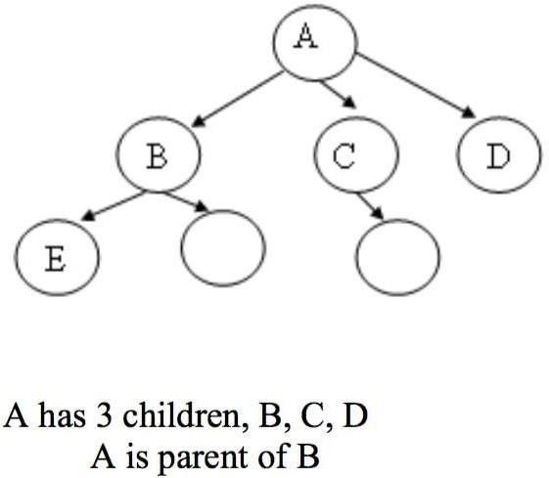
Tree
A tree is an abstract model of a hierarchical structure that consists of nodes with a parent-child relationship.
Tree is a sequence of nodes
There is a starting node known as a root node
Every node other than the root has a parentnode.
Nodes may have any number of children

Slide 6
Some Key Terms:
Root − Node at the top of the treeis called root.
Parent −Any node except root node has one edge upward to a node called parent.
Child − Node below a given node connected by its edge downward is called its child node.
Sibling – Child of same node are called siblings
Leaf − Node which does not have any child node is called leaf node.
Sub tree − Sub tree represents descendants of a node.
Levels − Level of a node represents the generation of a node. If root node is at level 0, then its next child node
is at level 1, its grandchild is at level 2 and soon.
keys − Key represents a value of a node based on which a search operation is to be carried out for a node.

Slide 7
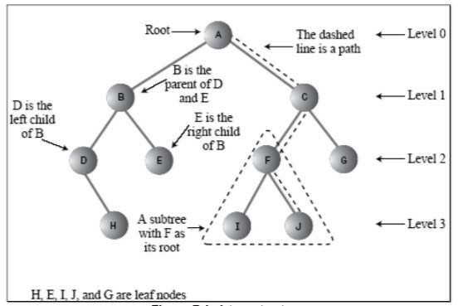

Slide 8
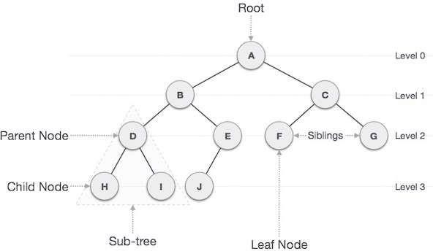

Slide 9
Some Key Terms:
Degree of a node:
The degree of a node is the number of children of that node
Degree of a Tree:
The degree of a tree is the maximum degree of nodes in a given tree
Path:
It is the sequence of consecutive edges from source node to destination node.
Height of a node:
The height of a node is the max path length from that node to a leaf node.
Height of atree:
The height of a tree is the height of the root.
Depth:
The depth of the node is the distance from the root node to that particular node.

Slide 10
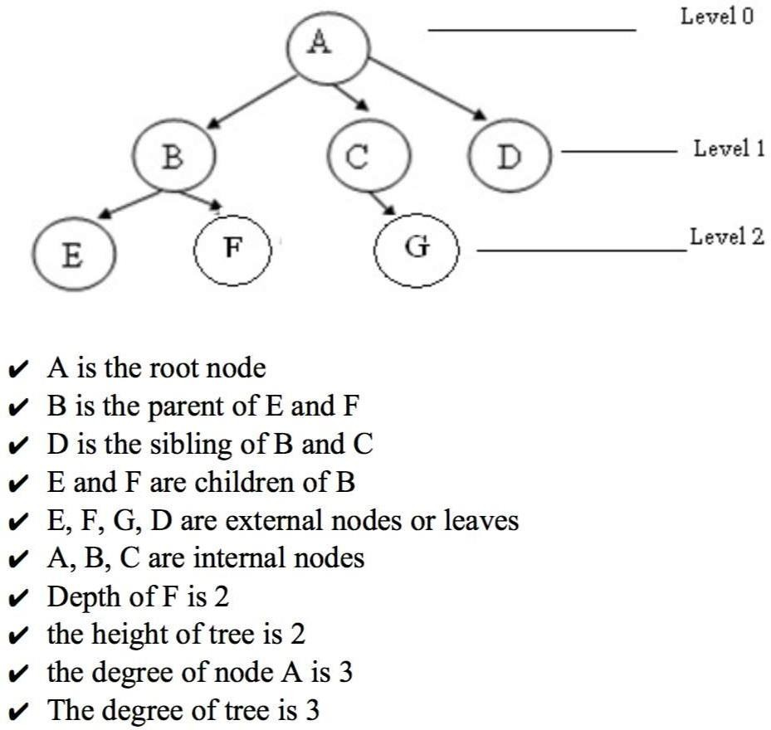

Slide 11
Characteristics of trees
Non-linear data structure
Combines advantages of an ordered array and linked list
Searching as fast as in ordered array
Insertion and deletion as fast as in linked list
Simple and fast

Slide 12
Application
Directory structure of a file store
Structure of an arithmetic expressions
Used in almost every 3D video game to determine what objects need to be
rendered.
Used in almost every high-bandwidth router for storingrouter-tables.
Used in compression algorithms, such as those used by the .jpeg and .mp3 file-formats.

Slide 13
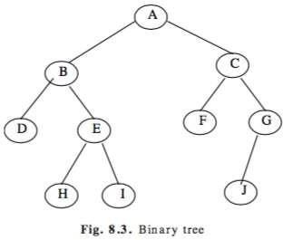
Introduction To Binary Trees
A binary tree, is a tree in which no node can have more than two children.
Consider a binary tree T, here ‘A’ is the root node of the binary tree T.
‘B’ is the left child of ‘A’ and ‘C’ is the right child of ‘A’
i.e A is a father of BandC.
The node B and C are cal ed siblings.
Nodes D,H,I,F,Jare leaf node

Slide 14
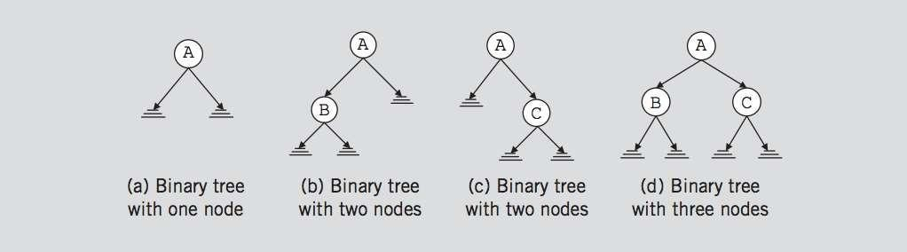
Binary Trees
A binary tree, T, is either empty or suchthat
T has a special node called the root node
T has two sets of nodes L_{T}and R_{T}, called the left subtree and right subtree of
T, respectively.
L_{T}and R_{T} are binary trees.
III.

Slide 15
Binary Tree
A binary tree is a finite set of elements that are either empty or is partitioned into three disjointsubsets.
The first subset contains a single element cal ed the root of the tree.
The other two subsets are themselves binary trees cal ed the left and right sub-trees of the originaltree.
Aleft or right sub-tree can be empty.
Each element of a binary tree is cal ed a node of the tree.

Slide 16
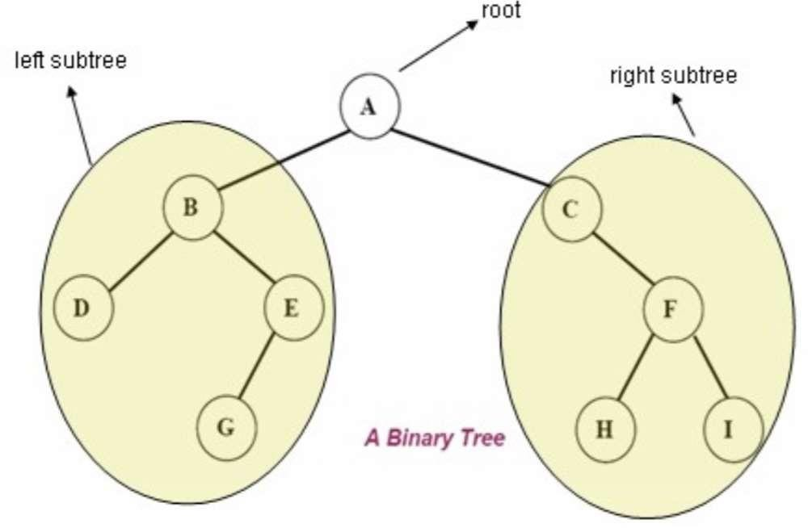
The following figure shows a binary tree with 9 nodes where A is theroot

Slide 17

Binary Tree
The root node of this binary tree is A.
The left sub tree of the root node, which we denoted by L_{A}, is the set L_{A} = {B,D,E,G} and the right sub tree of the root node, R_{A} is the set R_{A}={C,F,H}
The root node of L_{A} is node B, the root node of R_{A} is C and so on

Slide 18
Binary Tree Properties
The maximum number of nodes at level ‘l’ of a binary tree is 2^{l}
The Maximum number of nodes in a binary tree of height ‘h’ is 2^{h} – 1. (if root is at height 1)
The Maximum number of nodes in a binary tree of height ‘h’ is 2^{h+1} – 1. (if root is at height 0)
In a Binary Tree with N nodes, minimum possible height or the minimum number of levels is Log₂(N+1).
A Binary Tree with L leaves has at least | Log₂L |+ 1 levels.
In Binary tree where every node has 0 or 2 children, the number of leaf nodes is always one more than nodes with two children.
In a non empty binary tree, if n is the total number of nodes and e is the total number of edges, then e = n-1

Slide 19
Types of BinaryTree
Full Binary Tree
Complete binary tree
Skewed binary tree
Perfect binary tree

Slide 20
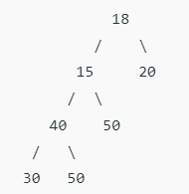
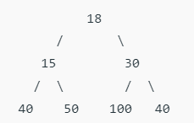
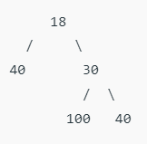
Full/Strict BinaryTree
A Binary Tree is a full binary tree if every node has 0 or 2 children.
We can also say a full binary tree is a binary tree in which all nodes except leaf nodes have two children.
This is also called proper binary tree. A strictly binary tree with N leaves always contains 2N – 1 nodes.

Slide 21
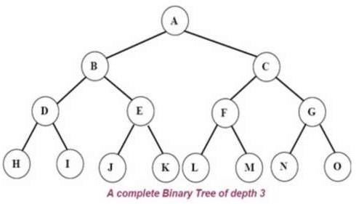
Complete binary tree
A complete binary tree is a binary tree in which every level, except possibly the last, is completely filled, and all nodes are as far left as possible.
A complete binary tree has 2^{d} nodes at every depth d and 2^{d} -1 non leaf nodes
A complete binary tree is just like a full binary tree, but with two major differences:
Every level must be completely filled
The last leaf element might not have a right sibling i.e. a complete binary tree doesn’t have to be a full binary tree.

Slide 22
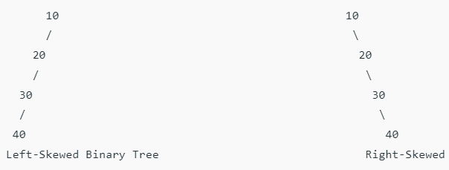
Perfect binary tree
A Binary tree is a Perfect Binary Tree in which all the internal nodes have two children and all leaf nodes are at the same level.
In a Perfect Binary Tree, the number of leaf nodes is the number of internal nodes plus 1
L = I + 1 Where L = Number of leaf nodes, I = Number of internal nodes.
Skewed binary tree
A skewed binary tree is a pathological/degenerate tree in which the tree is either dominated by the left nodes or the right nodes.

Slide 23
Representation of Tree (Array)
If a complete binary tree with n nodes (depth = log n + 1) is represented sequentially, then for any node with index i, 1<=i<=n, we have:
parent(i) is at i/2 if i!=1. If i=1, i is at the root and has no parent.
left_child(i) is at 2i if 2i<=n. If 2i>n, then i has no left child.
right_child(i) is at 2i+1 if 2i +1 <=n. If 2i +1 >n, then i has no right child.

Slide 24
Array Representation
[1]
[2]
[3]
[4]
[5]
[6]
[7]
[8]
[9]
A
B
C
D
E
F
G
H
I
[1]
[2]
[3]
[4]
[5]
[6]
[7]
[8]
[9]
.
[16]
A
B
--
C
--
--
--
D
--
.
E
A
B
A
C
B
C
D
E
D
E
F
G
H
I

Slide 25
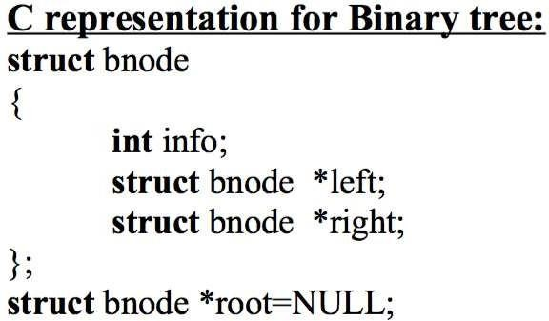
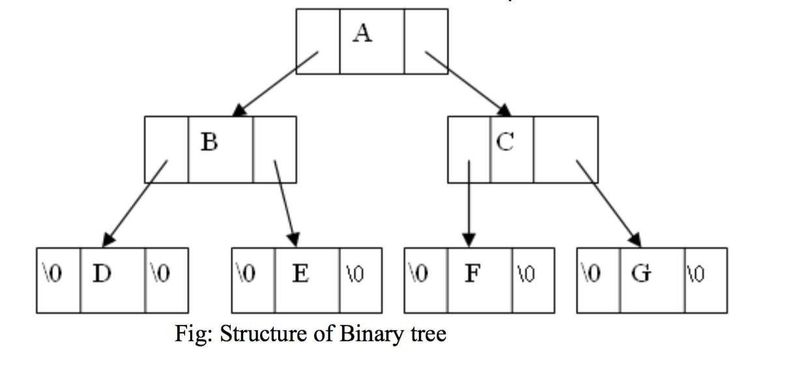
Representation of Tree (Linked List)

Slide 26
Operations on Binary Tree
Searching an existing node.
Inserting a new node.
Deleting an existing node.
Traversing the tree.
Preorder
Inorder
Postorder

Slide 27
Tree traversal
Traversal is a process to visit all the nodes of a tree and may print their values too.
All nodes are connected via edges (links) we always start from the root (head) node.
There are three ways which we use to traverse atree
In-order Traversal
Pre-order Traversal
Post-order Traversal
Generally we traverse a tree to search or locate given item or key in the tree or to print all the values it contains.

Slide 28
Pre-order, In-order, Post-order
Pre-order
<root><left><right>
In-order
<left><root><right>
Post-order
<left><right><root>

Slide 29
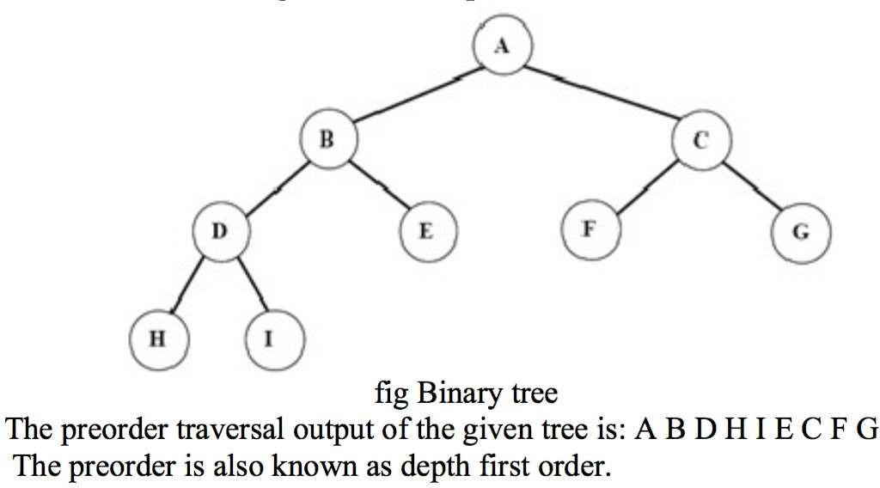
Pre-order Traversal
The preorder traversal of a non empty binary tree is defined as follows:
Visit the root node
Traverse the left sub-tree in preorder
Traverse the right sub-tree in preorder

Slide 30
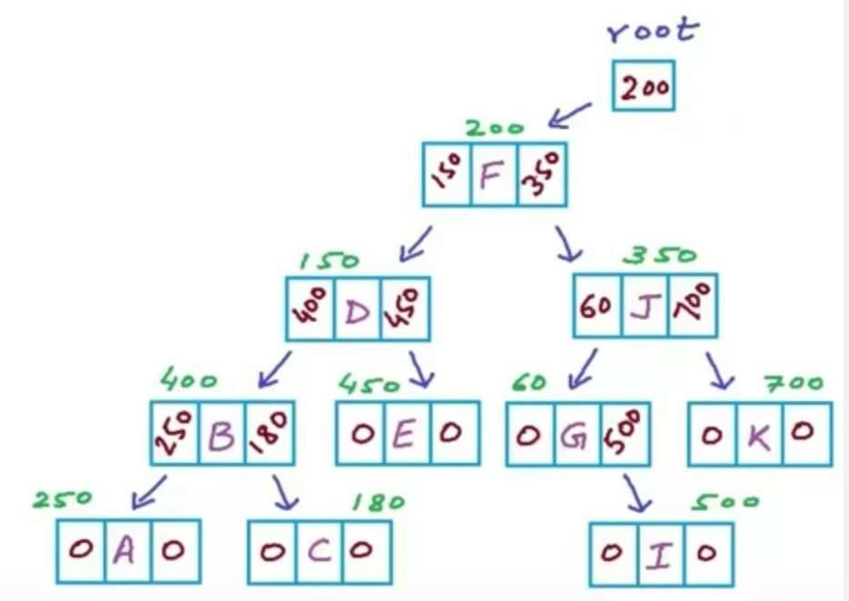
Pre-order Pseudocode
struct Node{ char data; Node *left; Node *right;
}
void Preorder(Node *root)
{
if (root==NULL) return;
printf (“%c”, root->data); Preorder(root->left); Preorder(root->right);
}

Slide 31
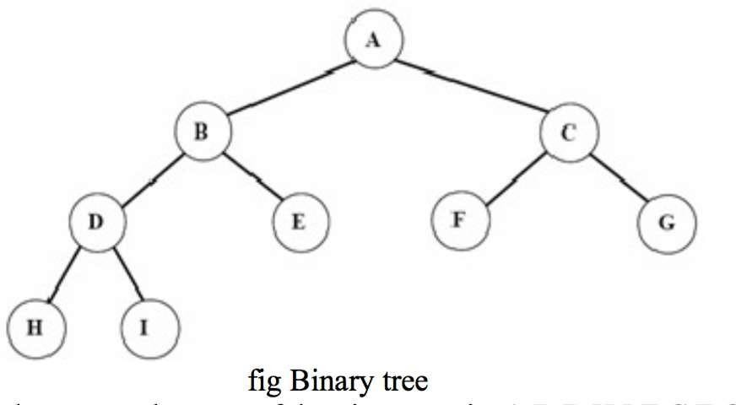
In-order traversal
The in-order traversal of a nonempty binary tree is defined asfollows:
Traverse the left sub-tree in in-order
Visit the root node
Traverse the right sub-tree in inorder
The in-order traversal outp of the given tree is
H D I B E A F C G
ut

Slide 32
In-order Pseudocode
struct Node{ char data; Node *left; Node *right;
}
void Inorder(Node *root)
{
if (root==NULL) return;
Inorder(root->left); printf (“%c”, root->data); Inorder(root->right);
}

Slide 33
Post-order traversal
The post-order traversal of a nonempty binary tree is defined asfollows:
Traverse the left sub-tree in post-order
Traverse the right sub-tree in post-order
Visit the root node
The post-order traversal output of the given tree is
H I D E B F G C A

Slide 34
Post-order Pseudocode
struct Node{ char data; Node *left; Node *right;
}
void Postorder(Node *root)
{
if (root==NULL) return;
Postorder(root->left); Postorder(root->right); printf (“%c”, root->data);
}

Slide 35
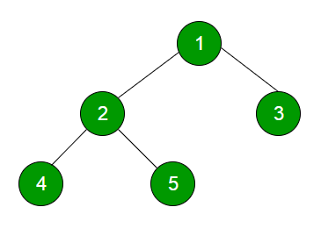
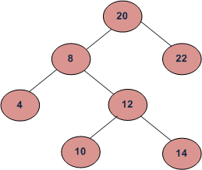
Level-order Traversal
20 8 22 4 12 10 14
1 2 3 4 5

Slide 36
Level-order Traversal using Queue
Create an empty queue q and push root in q.
Run While loop until q is not empty.
Initialize temp_node = q.front() and print temp_node->data.
Push temp_node’s children i.e. temp_node -> left then temp_node -> right to q
Pop front node from q.

Slide 37
Binary Search Tree(BST)
A binary search tree (BST) is a binary tree that is either empty or in which every node contains a key (value) and satisfies the following conditions:
All keys in the left sub-tree of the root are smaller than the key in the root node
All keys in the right sub-tree of the root are greater than the key in the root node
The left and right sub-trees of the root are again binary search trees

Slide 38
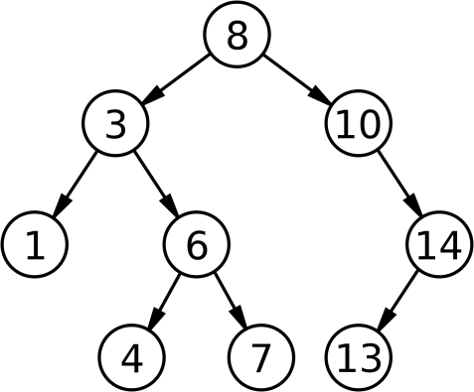
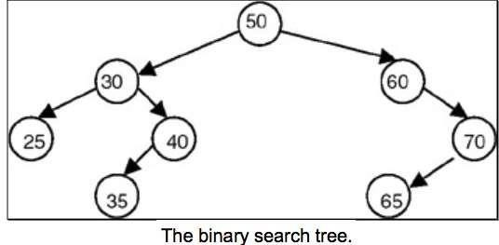
Binary Search Tree(BST)

Slide 39
Why Binary SearchTree?
Let us consider a problem of searching a list.
If a list is ordered searching becomes faster if we use contiguous list(array).
But if we need to make changes in the list, such as inserting new entries or deleting old entries, (SLOWER! !!) because insertion and deletion in a contiguous list requires moving many of the entries every time.

Slide 40
Why Binary SearchTree?
So we may think of using a linked list because it permits insertion and deletion to be carried out by adjusting only few pointers.
But in an n-linked list, there is no way to move through the list other than one node at a time, permitting only sequential access.
Binary trees provide an excellent solution to this problem. By making the entries of an ordered list into the nodes of a binary search tree, we find that we can search for a key in O(logn).

Slide 41
Searching Through The BST
Compare the target value with the element in the root node
If the target value is equal, the search is successful.
If target value is less, search the left subtree.
If target value is greater, search the right subtree.
If the subtree is empty, the search is unsuccessful.

Slide 42
Operations on Binary Search Tree(BST)
Fol owing operations can be done in BST:
Search(k, T): Search for key k in the tree T. If k is found in some node of tree then return true otherwise return false.
Insert(k, T): Insert a new node with value k in the info field in the tree T such that the property of BST is maintained.
Delete(k, T):Delete a node with value k in the info field from the tree T such that the property of BST is maintained.
FindMin(T), FindMax(T): Find minimum and maximum element from the
given nonempty BST.

Slide 43
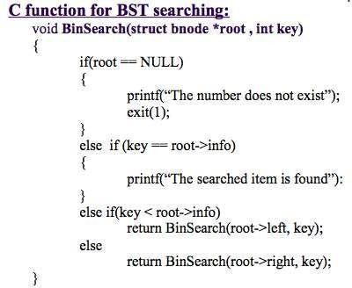

Slide 44
Insertion of a node in BST
To insert a new item in a tree, we must first verify that its key is different from those of existingelements.
If a new value is less, than the current node's value, go to the left subtree, else go to the right subtree.
Following this simple rule, the algorithm reaches a node, which has no left or right subtree.
By the moment a place for insertion is found, we can say for sure, that a new value has no duplicate in the tree.

Slide 45
Algorithm for insertion in BST
Check, whether value in current node and a new value are equal. If so, duplicate is found. Otherwise,
if a new value is less, than the node's value:
if a current node has no leftchild, place for insertion has been found;
otherwise, handle the left child with the same algorithm.
if a new value is greater, than the node's value:
if a current node has no right child, place forinsertion has been found;
otherwise, handle the right child with the same algorithm.

Slide 46
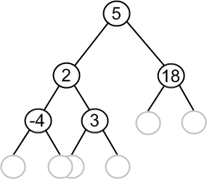
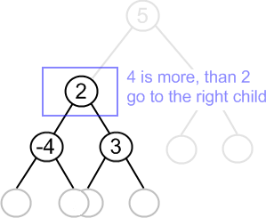
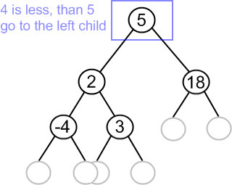
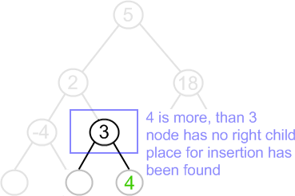
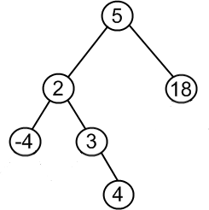

Slide 47
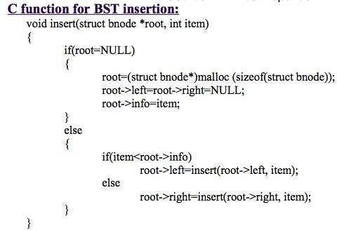

Slide 48
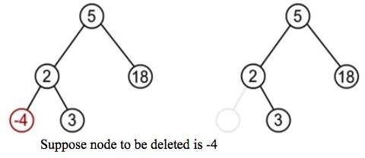
Deleting a node from theBST
While deleting a node from BST, there may be three cases:
The node to be deleted may be a leaf node:
In this case simply delete a node and set null pointer to its parents that side at which this deleted node exist.

Slide 49
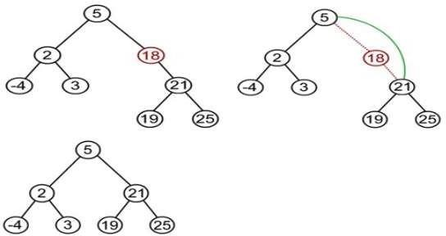
Deleting a node from theBST
The node to be deleted has one child
In this case the child of the node to be deleted is appended to its parent node. Suppose node to be deleted is 18

Slide 50
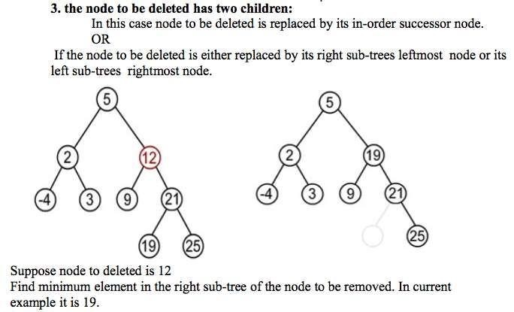
Deleting a node from theBST

Slide 51
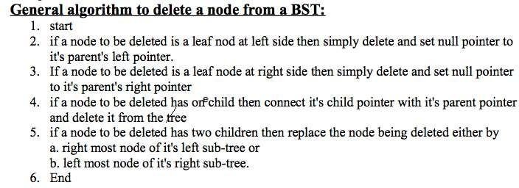

Slide 52
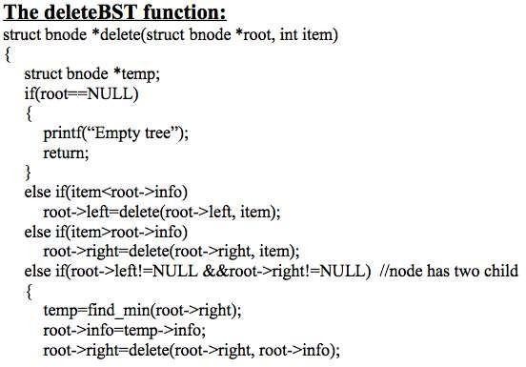
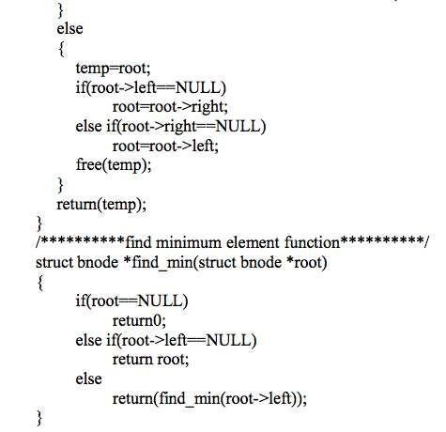

Slide 53
Huffman Algorithm
Huffman algorithm is a method for building an extended binarytree with a minimum weighted path length from a set of givenweights.
This is a method for the construction of minimum redundancycodes.
Applicable to many forms of datatransmission
multimedia codecs such as JPEGand MP3

Slide 54
Huffman Algorithm
1951, David Huffman found the “most efficient method of representing numbers, letters, and other symbols using binary code”. Now standard method used for data compression.
In Huffman Algorithm, a set of nodes assigned with values if fed to the algorithm. Initially 2 nodes are considered and their sum forms their parent node.
When a new element is considered, it can be added to thetree.
Its value and the previously calculated sum of the tree are used to form the new node which in turn becomes theirparent.

Slide 55
Huffman Algorithm
Let us take any four characters and their frequencies, and sort this listby increasing frequency.
Since to represent 4 characters the 2 bit is sufficient thus take initially two bits for each character this is cal ed fixed lengthcharacter.
character | frequencies
E | 10
T | 7
O | 5
A | 3
Character | frequencies | code
A | 3 | 00
O | 5 | 01
T | 7 | 10
E | 10 | 11
sor t
Here before using Huffman algorithm the total number of bits required is: nb=3*2+5*2+7*2+10*2 =06+10+14+20 =50bits

Slide 56
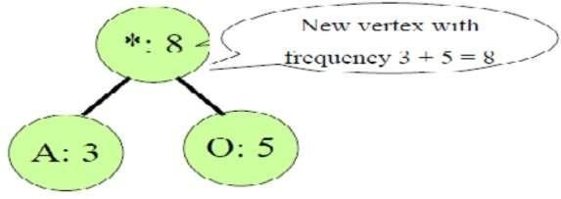
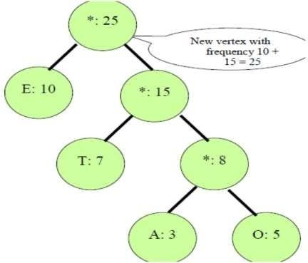
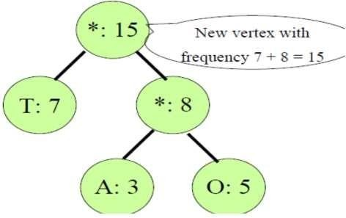

Slide 57
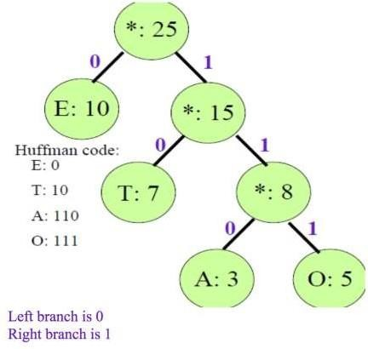
Character | frequencies | code
A | 3 | 110
O | 5 | 111
T | 7 | 10
E | 10 | 0
Thus after using Huffman algorithm the total number of bits required is
nb=3*3+5*3+7*2+10*1 =09+15+14+10 =48bits
i.e
(50-48)/50*100%=4%
Since in this smal example we save about 4%space by using Huffman algorithm. If we takelarge
example with a lot of characters and their frequencies we can save a lot of space

Slide 58
Huffman Algorithm
Lets say you have a set of numbers and their frequency of use and want to create a huffman encoding for them
Value | Frequencies
1 | 5
2 | 7
3 | 10
4 | 15
5 | 20
6 | 45

Slide 59
Huffman Algorithm
Creating a Huffman tree is simple. Sort this list by frequency and make the two-lowest elements into leaves, creating a parent node with a frequency that is the sum of the two lower element's frequencies:
12:*
/ \
5:1 7:2
The two elements are removed from the list and the new parent node, with frequency 12, is inserted into the list by frequency. So now the list, sorted by frequency, is:
10:3
12:*
15:4
20:5
45:6

Slide 60
Huffman Algorithm
You then repeat the loop, combining the two lowest elements. This results in:
22:*
/ \
10:3 12:*
/ \
5:1 7:2
The two elements are removed from the list and the new parent node, with frequency 12, is inserted into the list by frequency. So now the list, sorted by frequency, is:
15:4
20:5
22: *
45:6

Slide 61
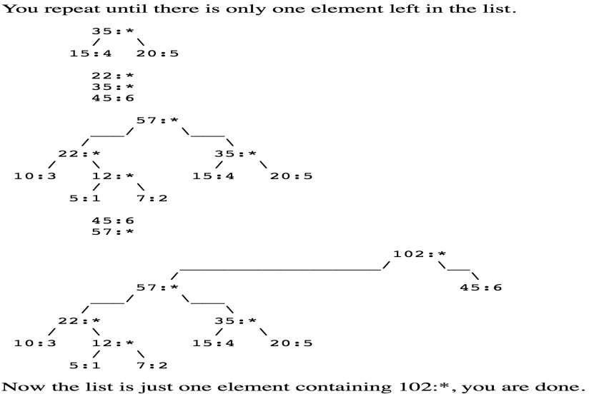
Huffman Algorithm

Slide 62
Huffman Algorithm
Value | C | D | E | K | L | M | U | Z
Frequency | 32 | 42 | 120 | 7 | 42 | 24 | 37 | 2
After sorted
Value | Z | K | M | C | L | D | U | E
Frequency | 2 | 7 | 24 | 32 | 42 | 42 | 37 | 120
We can represent it using 3 bit

Slide 63
Huffman Algorithm
Find code for
DEED
MUCK
Try to decode the bit string 1011001110111101

Slide 64
Assignments
Slides at myblog
http://www.ashimlamichhane.com.np/2016/07/tree-slide-for- data- structure-and-algorithm/
Assignments at github
https://github.com/ashim888/dataStructureAndAlgorithm/tree/dev/ As signments/assignment_7

Slide 65
Reference
https://www.siggraph.org/education/materials/HyperGraph/video/mp eg/mpegfaq/huffman_tutorial.html
https://en.wikipedia.org/wiki/Binary_search_tree
https://www.cs.swarthmore.edu/~newhall/unixhelp/Java_bst.pdf
https://www.cs.usfca.edu/~gal es/visualization/BST.html
https://www.cs.rochester.edu/~gildea/csc282/slides/C12-bst.pdf
http://www.tutorialspoint.com/data_structures_algorithms/tree_data
_structure.htm

